Slide 1

Cassandra' 21
CREATORZ
AMAN MISHRA MAINAK SAMANTA AKSHAT SOOD

Slide 2

Comprehending the data and hypothesis formulation
Correlation and Outlier effects
Features Analysis and NaN values hypothesis
Data preprocessing and Feature Engineering with Aggregation and Binning
Model Fitting with their scores (Mean-F1 on CV)
Train/Test Similarity and conflicts in Cross-validation.

Slide 3
Data Understanding
with Hypothesis Formulation

Slide 4
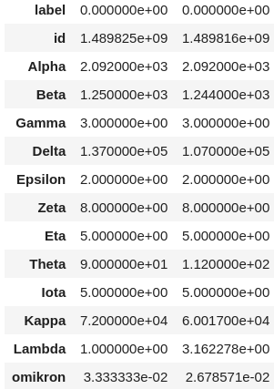
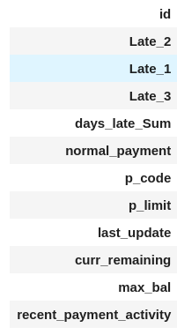
Demographics Data
Payment Histories
DATA

Slide 5
Based on the three aspects i.e. Intuition, Plotting Features and Surfing the net for different features we boiled down to the following inferences
1) Dataset is not of bank loan but about credit card owing to the features p_limit and repayments.
2) Epsilon has 2 unique values and thus after surfing through internet about this type of data we hypothesize that this feature may indicate sex of the individual i.e. male (0) and female (1)
3) Gamma - Which contains 3 unique value may be the location from where customer is belonging i.e., to Urban, Rural or Suburban areas.
Features
Hypothesis

Slide 6
4) Theta is positive integer value which represents the age of the person encoded in some style to make the maximum at 115 and min at 60
5) Out of Delta and Kappa one must depict the salary of the person.
6) Last but not the least, Alpha which has 4 unique value seems to be random but actually in data it is modified ,if we divide Alpha by 523 we get resultant unique values as 1, 2, 3 ,4 ,5 , 6 and 7 which is quite expressive to observe, it may represent the educational qualification of that customer whether they passed out of high school
Features
Hypothesis

Slide 7
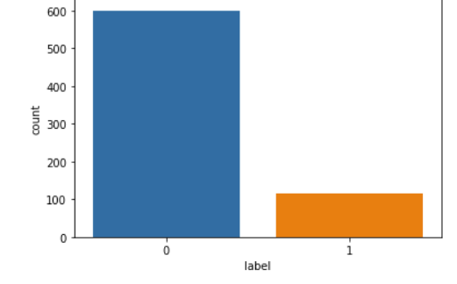
Response Variable
We have to perdict either the customer is defaulter (1) or not (0)
We have an unbalanced distribution of classes.

Slide 8
Correlations and Outliers

Slide 9
Outliers
Outlier is a special entity that must be addressed whenever we are dealing with data collinearity.
Our Outlier handling Approach includes:
Finding rows in train demographics data that contain outliers in more than two rows.
Used the method of quartile deviation with larger Inter-Quartile Range
Got 96 columns 88 0's and 8 1's, dropped 0 ones.

Slide 10
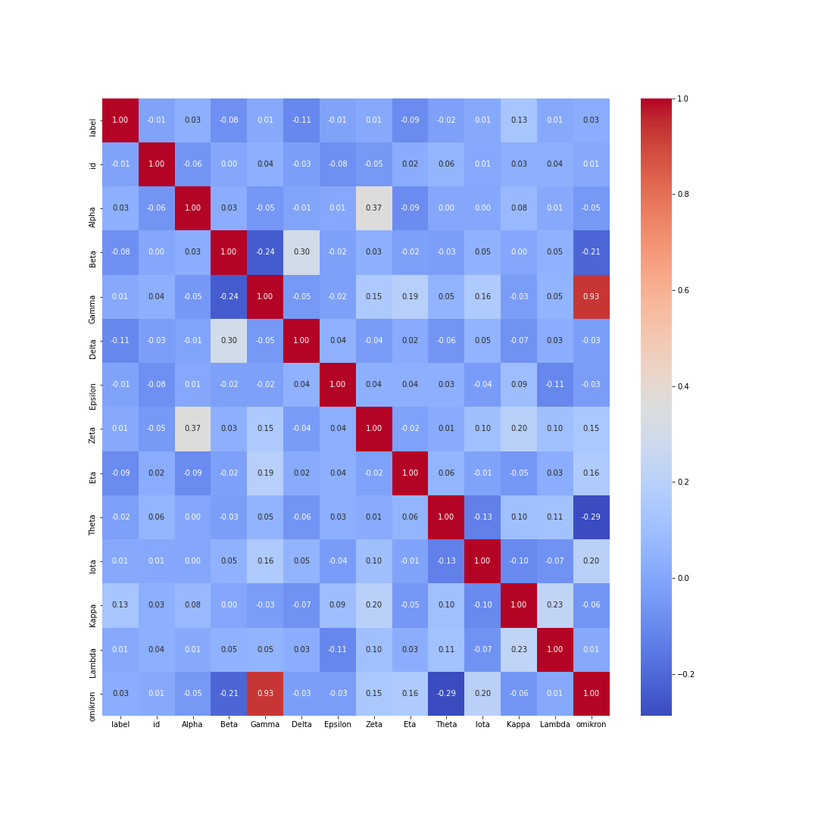
Effects on Correlation
Correlation heatmap without removal
Correlation heatmap with outlier removal

Slide 11
Takeaways from Maps
Outlier removal increased the correlation of some features with the target.
It made us believe that the outlier is actually noise.
Like for Kappa, correlation increased from 0.02 to 0.13.
Delta from 0.11 to 0.14
Negative correlation of Beta also increased
And we found that it actually boost the performance of the model.

Slide 12
Features Analysis and
NaNs Hypothesis

Slide 13
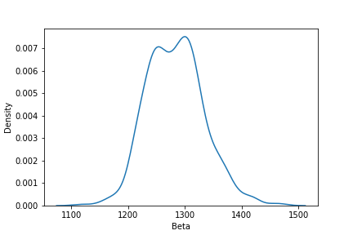
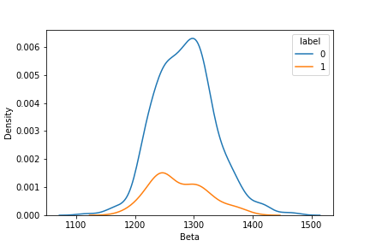
We made several plots of different variables to analyze their distribution and relation with targets.
Feature Beta distribution.
Beta with labels

Slide 14
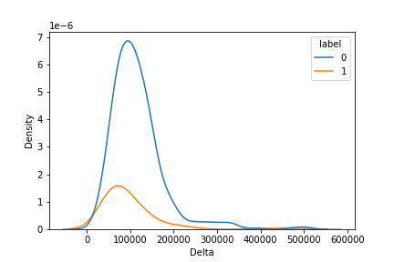
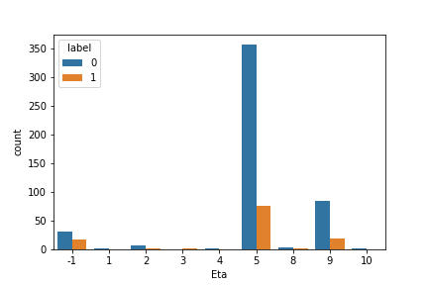
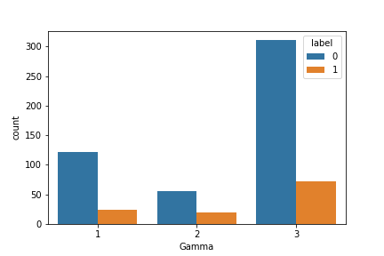
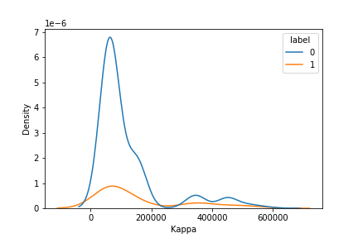
Delta with labels.
Eta with labels
Gamma with labels
Kappa with labels .

Slide 15
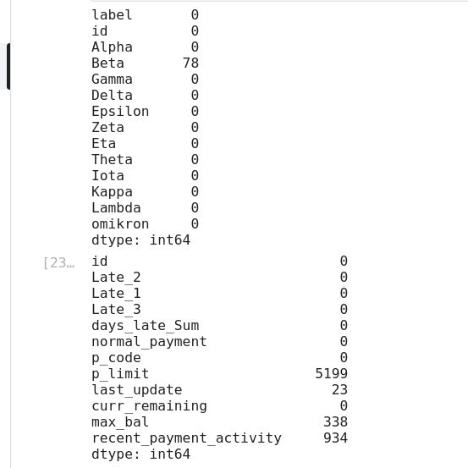
Missing values
Demographics
Payment history
Only Beta with NaN values
p_limit, last_update,
max_bal, recent_payment_activity
have NaN values

Slide 16
If we fill such large amount of NaNs with mean or median without knowing about it then it may cause the performance to degrade.
Hence, we went on to analyse each features containing NaN values individually one by one.
Beta - From above plots we found beta to be a numerical feature sampled from an approximate normal distribution, so we can substitute nan with median of this feature.
For other history features we sorted the data on basis of ids and last_update dates and extract some ids history to analyse nans.

Slide 17
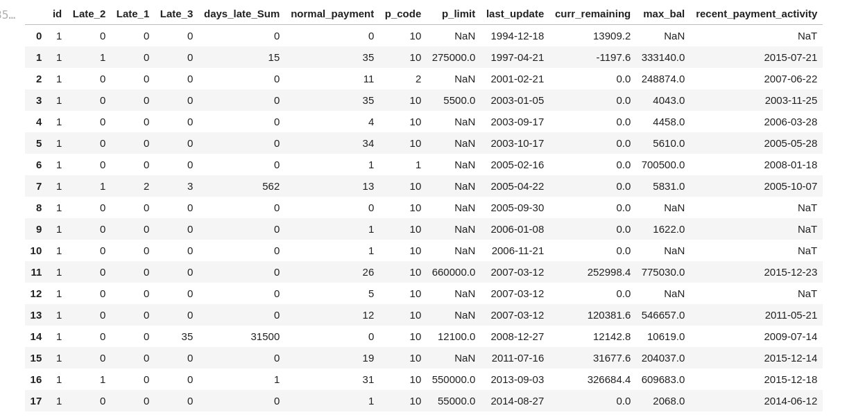
Payment history of a single ID, ID==1

Slide 18
HYPOTHESIS FROM ABOVE DATAFRAME
p_limit NaNs are subject to domain.
Similar for max_bal.
Found a method to fill last update and recent_payment activity by the corresponding last transactions of that user till that time of previous payment.

Slide 19
Data Preprocessing and
Feature Engineering

Slide 20
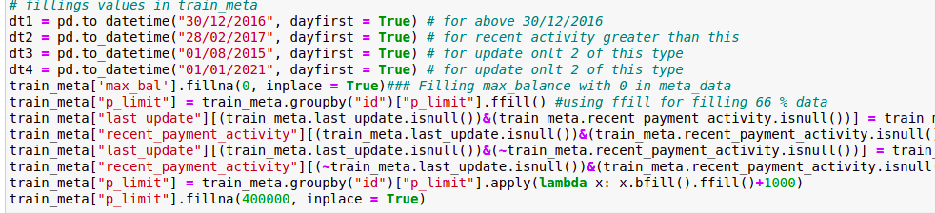
NaN's Filling
In this way we filled the NaN values on Basis of our hypothesis

Slide 21
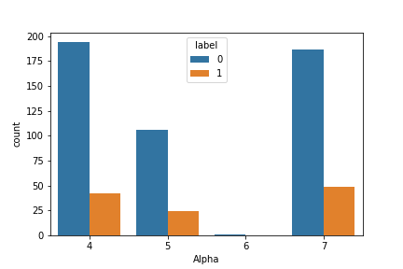
Feature Transformation and Binning
As mentioned divided Alpha by 523 to get a categorical variable.
Binning of Theta into several groups to represent an age type group.
Using Distribution of Delta, made a new categorical feature using splits.

Slide 22
Aggregation
On the Basis of our hypothesis we tried to aggregated features of payment history to made new features which will boost performance.
We Aggregated features using Domain knowledge, intuition and our hypothesis as follows:
curr_remaining-max_ball>0 feature agg in terms of everyhting(both as a category label and numerical label)
variation of product limits how freuently changes(montonocity in this as well)
monotnicity in curr_balance and max_bal
days late sum aggregation
amount of each late type aggregate
ratios of 4th, 5th
number of normal_payments/per_unit_time
binning of days_late_sum

Slide 23
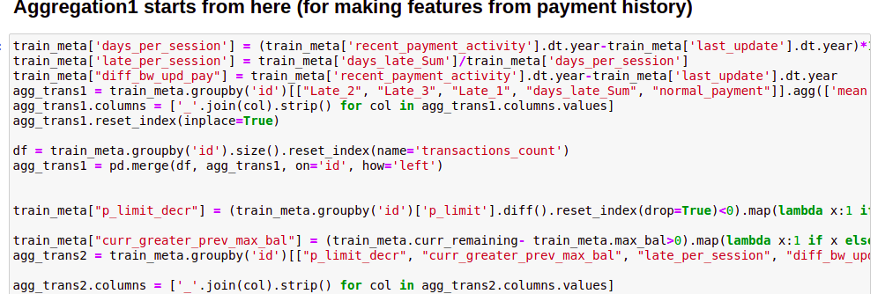
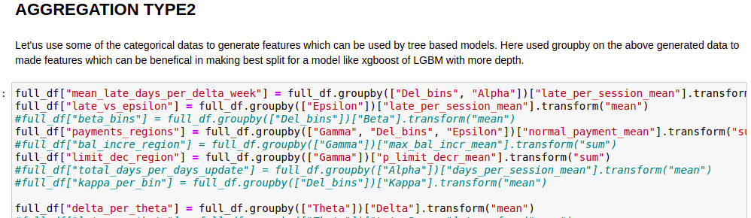

Slide 24
Model Fitting with their scores
(Mean F-1 with CV)

Slide 25
Before Aggregation
After Aggregation
Models
Train score
CV score
Train score
CV score
Logistic Regression
0.55
0.49
0.59
0.51
Random Forest
1
0.55
0.98
0.59
Dicision Tree
1
0.52
1
0.52
Adaboost
0.85
0.63
0.89
0.65
Gradient Boosting
0.88
0.69
0.9
0.7
LGBM
0.84
0.71
0.86
0.72

Slide 26
XGBoost
0.88
0.70
0.9
0.71
CatBoost
0.85
0.68
0.87
0.7
SVM (with rbf kernel)
0.8
0.68
0.81
0.66
Extra Trees
0.98
0.57
0.98
0.56
On the basis of the above base CV scores, we have chosen two models for further Hyper Parameter Tuning which are :-
XGBoost
LGBM

Slide 27
For Hyperparameter tuning there are different methods in Scikit-learn like GridSearchCV, RandomSearchCV. These methods are useful for Hyperparameter tuning but there are some drawbacks.
Among GridSearchCV and RandomSearchCV, RandomSearchCV performes better than GridSearchCV.
But these two methods are unable to span effectively over the hyperparameter space.
Also both of these methods are much slower.
Keeping all the aspects in mind we have decided to use Optuna for the Hyperparameter tuning as Optuna is both faster and effective.

Slide 28
We have tuned the Hyperparameters of LGBM and XGBoost using Optuna.
The best parameters for LGBM comes out to be-
'n_estimators': 876, 'num_leaves': 70, 'scale_pos_weight': 5,
'max_depth': 50, 'learning_rate': 0.07767353478949224, 'min_split_gain': 0.00870738026281286, 'feature_fraction': 0.3561368369391315, 'bagging_freq': 0
The best parameters for XGBoost comes out to be-
'booster' : 'gbtree', 'max_depth' : 25, 'gamma' : 12, 'eta' : 0.08,
'objective' : 'binary:logistic', 'scale_pos_weight':1, 'eval_metric': 'auc',
'subsample' : 0.8, 'colsample_bytree' : 0.85, 'min_child_weight' : 3, 'max_delta_step' : 2, 'random_state':42

Slide 29
After tuning and Feature aggregation the Training and CV scores for the two models are:-
LGBM-
Training Accuracy- 0.88
Validation Accuracy- 0.735
XGBoost-
Training Accuracy- 0.89
Validation Accuracy- 0.71
According to the post tuning Cross Validation scores we have submitted the LGBM predictions.
The model responded to some of the features made by us which can be seen in the graph below

Slide 30
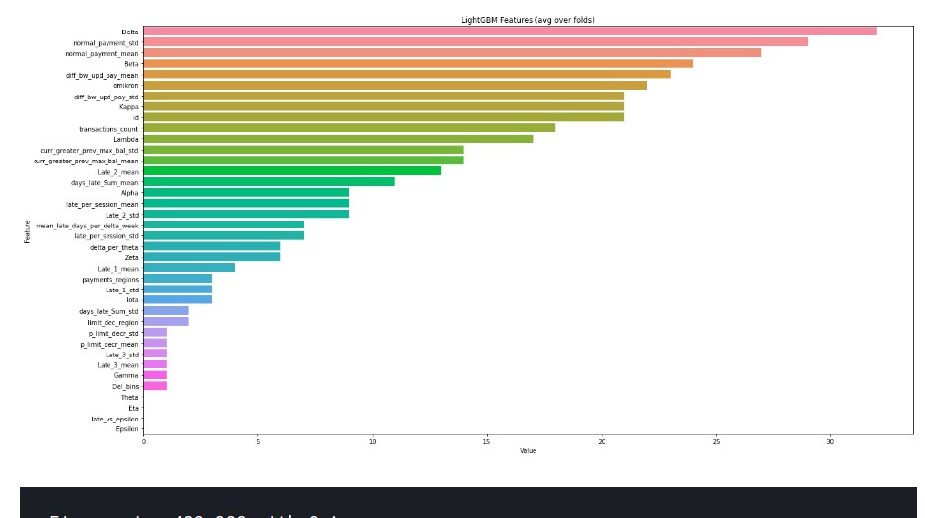

Slide 31
Train/Test Similarity and Conflicts in
Cross-validation

Slide 32
Sometimes working on a Ml problem we find that our model gives good predictions on the validation data but not on the test data. That means the input features(covariate) of our validation/train data follows a different distribution than our test data. this is known as Covariate shift.
The covariates are some features (often represented by X ) with an associated response variable y , and our goal in machine-learning is to compute p(y|x,model) using some model.
The expected loss (l) of a model on the test data is written, E[l(f(Xtest),y)] where f(x) maps X to y' . It is related to the expected training loss by a factor β=p(Xte)/p(Xtrain) , i.e.
E[l(f(Xtest),y)]=E[{p(Xtest)/p(Xtrain)}*l(f(Xtrain),y)]

Slide 33
A simple way to find out wheather a data has Covariate Shift or not is to train a discriminative classifier to learn the P(Xtrain|D) for the dataset D.
So we have labelled the all the training data as 1 and all the testing data as 0 and trained a classifier on them.
On the validation set we have tested our classifier which has given an accuracy of approx 0.7
As the accuracy is more than 50% so it means up to some limit the model can distinguish between the Training and Testing data which shows that the train and test data distributions are not similar.

Slide 34
Thank you

